Slide 1
Using the SQL PROVIDER
SQL Server on the command line
Rob Sewell @sqldbawithbeard

Slide 2
Agenda
What is it?
How can I get it?
What can I do?

Slide 3
What is it?
The SQL Server provider exposes the hierarchy of SQL Server objects in paths similar to file system paths.
You can use the paths to locate an object
You can use methods from the SQL Server Management Object (SMO) models to perform actions on the objects.
https://docs.microsoft.com/en-us/sql/relational-databases/scripting/sql-server-powershell-provider

Slide 4
How can I get it?
On the client machine you need to have the SQL Server Management Objects
Install latest SSMS from https://sqlps.io/dl

Slide 5
How can I get it?
Or – go to https://sqlps.io/smoonly and install
Microsoft® System CLR Types for Microsoft SQL Server® 2016 (SQLSysClrTypes.msi)
Microsoft® SQL Server® 2016 Shared Management Objects (SharedManagementObjects.msi)
Microsoft® Windows PowerShell Extensions for Microsoft SQL Server® 2016 (PowerShellTools.msi)

Slide 6
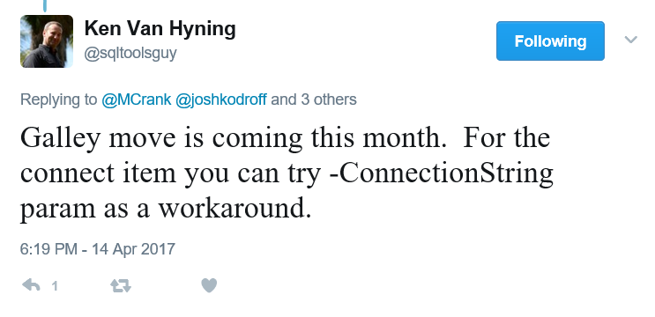
How can I get it?
From the PowerShell Gallery*
Install-Module sqlserver

Slide 7

What Can I Do?
It‘s PowerShell ☺

Slide 8

Enough Chat – Show us some Code!
Time For a Demo

Slide 9
Summary
SQL Server Provider enables you to navigate SQL Server like its a file structure
It‘s just PowerShell and just SMO – Use Get-Member to find the methods
There is no SSRS .............................. Yet
dbatools is awesome! https://dbatools.io

Slide 10
Questions?

Slide 11
Next Steps...
Now: 15 min break
Grab a coffee
Stay here to enjoy next presentation
Change track and switch to another room
Ask me questions or meet me in a breakout session room afterwards

Slide 12
About_Author
Rob Sewell
UK Based PowerShell, Azure, Automation, SQL (PaaS geddit?)
https://sqldbawithAbeard.com
@sqldbawithbeard

